Slide 1


SMART INDIA HACKATHON 2026
TITLE PAGE
PROBLEM STATEMENT ID | 26189
PROBLEM STATEMENT | AI POWERED CRIMINAL NETWORK ANALYSIS
THEME | POWERED AI FOR ACCLERATING INVESTIGATION
PS CATEGORY | SOFTWARE
TEAM ID
TEAM NAME | CYBER RAKSHAK

Slide 2

CYBER RAKSHAK AI-Powered Criminal Network Analysis & Investigation Portal
What we are introducing?
Feature | Purpose
Multi-Source Data Integration | Combines fragmented investigation data
Entity Identification | Identifies people, phones, vehicles, locations, cases, etc.
Relationship Mapping | Finds connections between entities
Interactive Network Graph | Visualizes the complete network
AI Pattern Analysis | Detects meaningful patterns
Anomaly Detection | Highlights unusual relationships/activities
Risk Indicator | Helps prioritize investigation
Timeline Analysis | Understands events chronologically
Case Linking | Connects related cases/entities
Explainable Results | Shows reasons behind generated indicators
Investigator Dashboard | Provides one unified investigation interface
Human-in-the-Loop | Keeps final judgment with the investigator
An AI-driven platform that combines heterogeneous public and investigative data to identify suspicious patterns, analyze relationships between entities, and assist investigators in discovering potential criminal networks.
Key Innovation

Slide 3
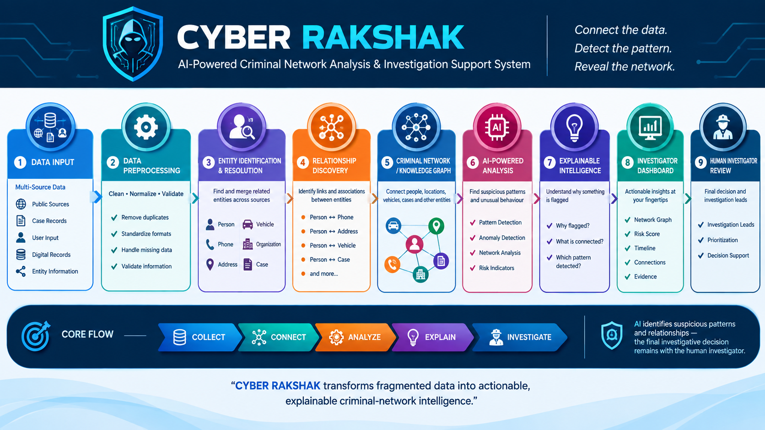
How it works?

Slide 4
TECHNICAL APPROACH
Innovation | Technology Used | Purpose
Multi-Source Data Fusion | Python, Pandas | Collect, clean & combine heterogeneous data
Entity Resolution | Python, Fuzzy Matching / NLP | Identify matching or related entities
Relationship Discovery | NetworkX | Find relationships between people, phones, addresses, vehicles & cases
Criminal Network Graph | NetworkX + Graph Visualization | Visualize hidden connections and network structures
AI Pattern Analysis | Scikit-learn / ML Models | Detect anomalies and suspicious patterns
Text Intelligence | NLP | Extract useful entities and information from text
Risk Intelligence | Python + ML/Rule-based Scoring | Generate explainable risk indicators
Interactive Dashboard | Streamlit | Provide investigator-facing analysis interface
Data Storage | JSON / CSV / Server Storage | Persist investigation and application data
Explainable Results | Rule/Feature-based Explanation | Show why an entity or network was flagged

Slide 5
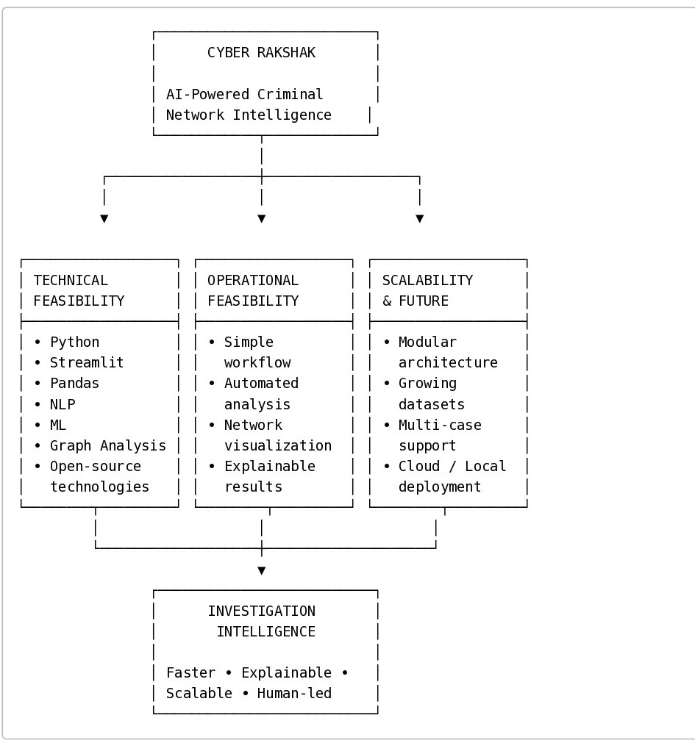
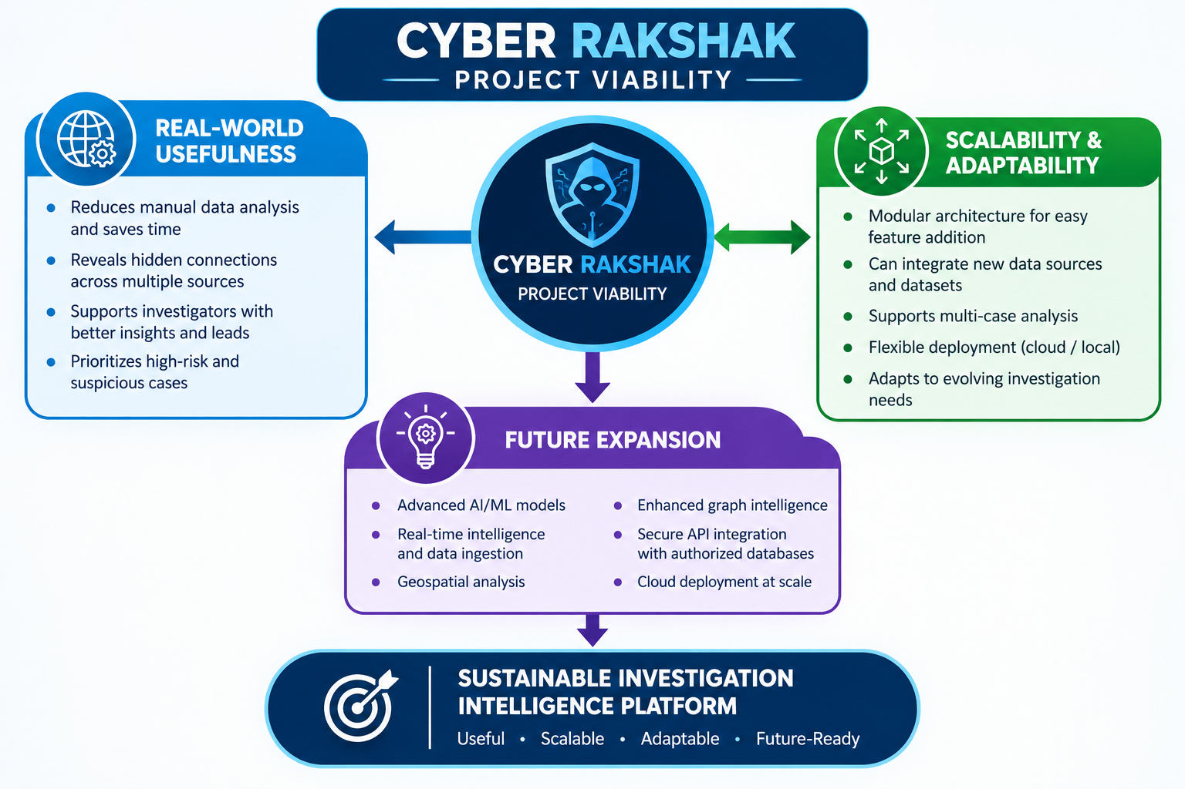
FEASIBILITY AND VIABILITY
FEASIBILITY
VIABILITY

Slide 6
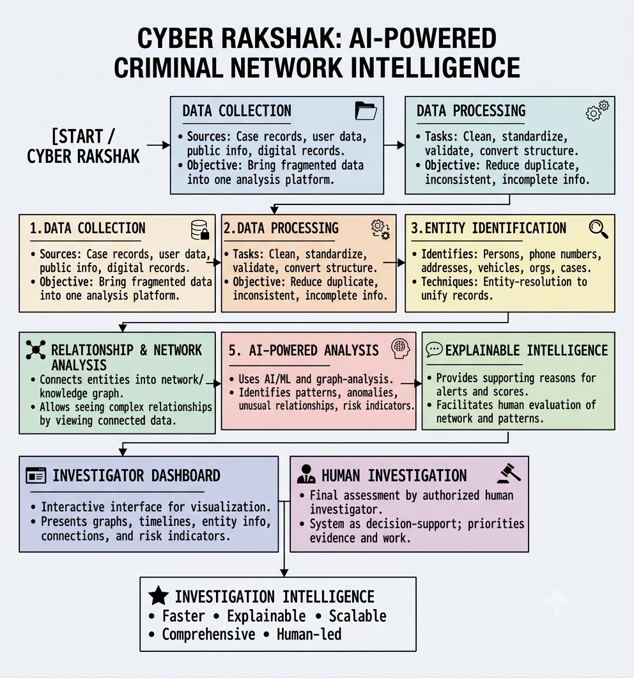
WORKING PROCEDURE ON PORTAL

Slide 7
BENEFITS
RESEARCH AND REFERENCES
BENEFITS OF CYBER RAKSHAK
⚡ Faster Investigation — Reduces time spent on manual data correlation.
🔗 Hidden Connection Discovery — Reveals relationships between people, cases, locations, vehicles and other entities.
🧠 AI-Assisted Analysis — Detects suspicious patterns and anomalies across connected data.
📊 Better Decision Support — Provides network graphs, timelines, risk indicators and explainable insights.
🎯 Investigation Prioritization — Helps investigators identify cases and relationships that may require closer attention.
🔍 Centralized Intelligence — Brings fragmented information into a unified investigation view.
👮 Human-in-the-Loop — Supports investigators while keeping final decisions with authorized human experts.
📈 Scalable Platform — Can be expanded with new datasets, analytical models and authorized data sources.
USING CHATGPT AND GEMINI:-
https://chatgpt.com/features/deep-research/?utm_source=chatgpt.com
ON YOUTUBE:-
https://youtu.be/qXS75gvT8_A?si=0ISiUE2F8FNZtB7c
https://youtu.be/qXS75gvT8_A?si=0ISiUE2F8FNZtB7c
GITHUB:-
https://github.com/iamharshsharma108-gif/SIH26189.git

